Slide 1
Introduction to Algorithms
Levon Prazyan

Slide 2
Course Overview
Introduction
Sorting and Searching
Arrays and Lists
Stacks and Queues, Double Ended Queue
Heaps
Trees
Hash Tables
Dynamic Programming
Greedy Algorithms
Graph Algorithms
Network Flow
NP-Completeness

Slide 3
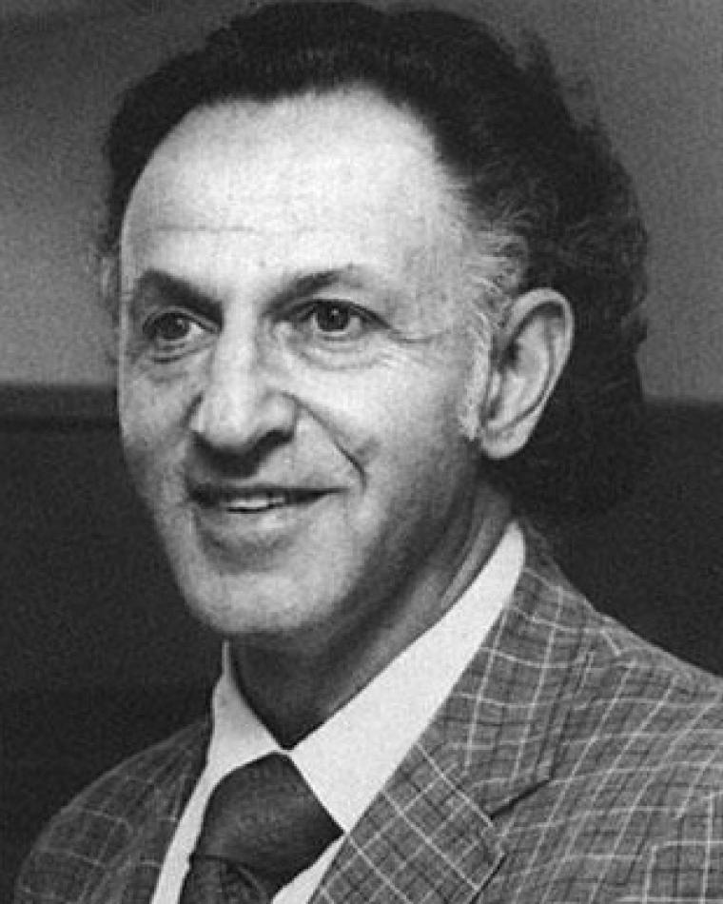
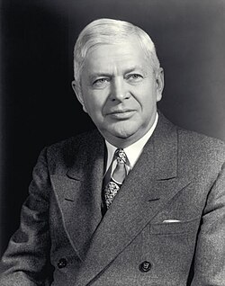
Dynmamic Programming
Richard Bellman
Charles Erwin Wilson (Engine Charlie)
Notes:
Richard Bellman
“I was interested in naming… but the Secretary of Defense had a pathological fear and hatred of the word ‘research’. I therefore chose the word programming. I wanted to get across the idea that this was dynamic, multi-stage decision making.”
Charles Erwin Wilson
Charles Erwin Wilson (1890–1961) was an American engineer, businessman, and government official who served as U.S. Secretary of Defense from 1953 to 1957 under President Dwight D. Eisenhower. Nicknamed “Engine Charlie,” he was best known for his prior leadership of General Motors and his remark linking the company’s success to that of the nation.
It's neither "dynamic" nor "programming" in the modern sense

Slide 4
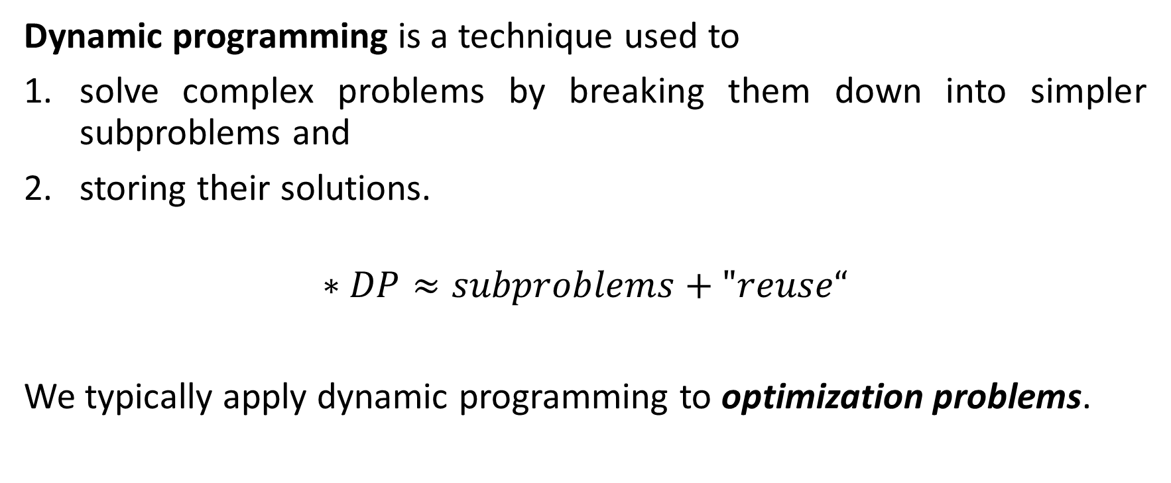
Dynamic Programming (DP)
Dynamic programming is a technique used to
solve complex problems by breaking them down into simpler subproblems and
storing their solutions.
$$∗DP≈subproblems+"reuse“$$
We typically apply dynamic programming to optimization problems.
Notes:
Unlike divide-and-conquer approach, the dynamic programming share solution of subproblems

Slide 5
Key Concepts of DP
Optimal Substructure:
A problem exhibits optimal substructure if an optimal solution to the problem can be constructed efficiently from optimal solutions of its subproblems. This property is fundamental for employing dynamic programming.
Overlapping Subproblems:
Dynamic programming is effective for problems with overlapping subproblems, meaning the same subproblems are solved multiple times. By solving each subproblem only once and storing the results, DP reduces the total number of computations.
Notes:
A classic example of a problem that does not exhibit optimal substructure is the Traveling Salesman Problem (TSP) under certain conditions
Traveling Salesman Problem:
Problem Statement: Given a list of cities and the distances between every pair of cities, the task is to find the shortest possible route that visits each city exactly once and returns to the original city.
Why Optimal Substructure is Not Applicable:
Global Nature: The TSP requires considering the entire set of cities simultaneously to ensure that the chosen path is globally optimal. This means the optimal path from city A to B doesn't necessarily lead to an optimal solution for the entire problem.
Subset Solutions May Not Combine: Unlike problems with optimal substructure, solving a subset of the cities optimally doesn't guarantee that adding another city will lead to a globally optimal solution. For example, choosing the shortest path through a subset of cities may result in an infeasible or suboptimal path when additional cities are added.
Dynamic Connections: Each city's role changes based on previous and subsequent cities, meaning the "optimal connections" are heavily dependent on the complete context of the path.

Slide 6
Dynamic Programming Approaches
Memoization: top-down approach.
You recursively solve the subproblems and store their results in a data structure.
If you encounter the same subproblem again, you use the stored result instead of recomputing it.
Tabulation: bottom-up approach.
You iteratively solve all subproblems starting from the smallest one, and
build up to the solution of the entire problem by storing intermediate results.
Notes:
Memoization vs. Tabulation:
Memoization: This is a top-down approach. You recursively solve the subproblems and store their results in a data structure (typically an array or hash table). If you encounter the same subproblem again, you use the stored result instead of recomputing it.
Tabulation: This is a bottom-up approach. You iteratively solve all subproblems starting from the smallest one, and build up to the solution of the entire problem by storing intermediate results in a table.
Examples:
Fibonacci Sequence: Calculating Fibonacci numbers is a classic example where dynamic programming can significantly speed up computation by avoiding redundant calculations.
Knapsack Problem: A classic optimization problem where you determine the maximum value of items that can be packed into a knapsack with capacity constraints.
Shortest Path Algorithms: Algorithms like Floyd-Warshall for finding shortest paths in weighted graphs use dynamic programming principles.

Slide 7
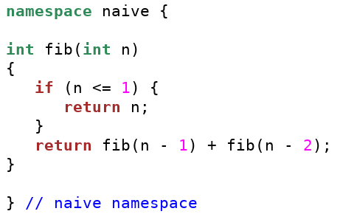

DP Problem: Fibonacci Number (1)
Time Complexity: $O\left(2^{n}\right)$
Memory usage: $O\left(1\right)$

Slide 8
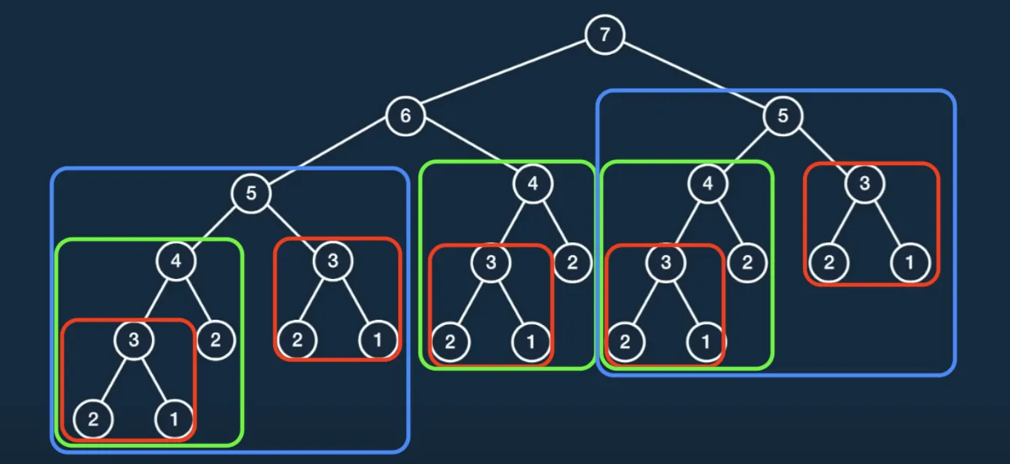
DP Problem: Fibonacci Number (2)

Slide 9
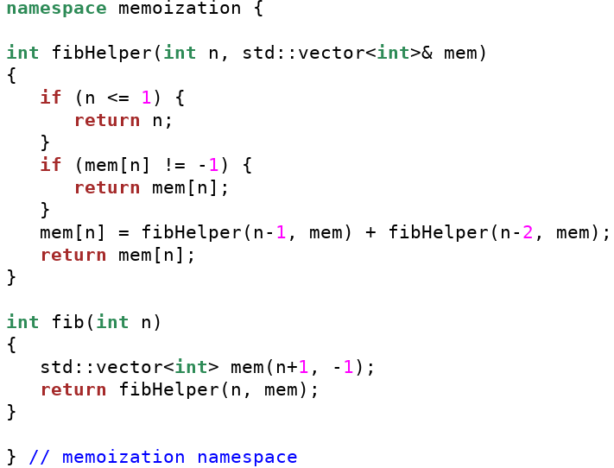

DP Problem: Fibonacci Number (3)
Time Complexity: $O\left(n\right)$
Memory usage: $O\left(n\right)$

Slide 10
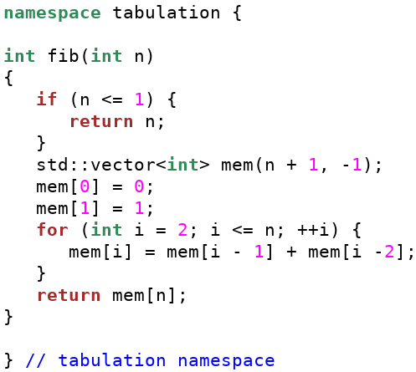

DP Problem: Fibonacci Number (4)
Time Complexity: $O\left(n\right)$
Memory usage: $O\left(n\right)$

Slide 11
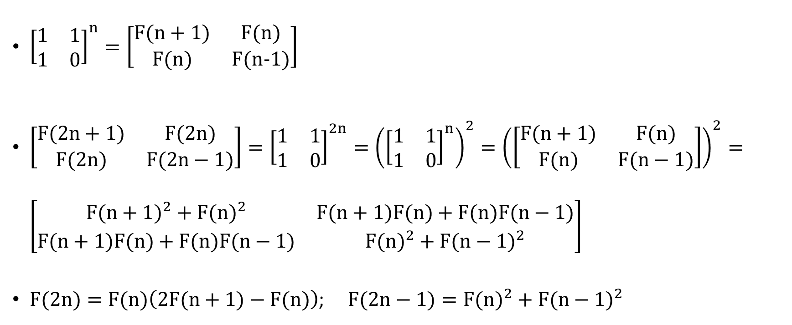
DP Problem: Fibonacci Number (5)
${\left[\begin{matrix}1 & 1 \\ 1 & 0\end{matrix}\right]}^{n}=\left[\begin{matrix}F(n+1) & F(n) \\ F(n) & F(n−1)\end{matrix}\right]$
$\left[\begin{matrix}F(2n+1) & F(2n) \\ F(2n) & F(2n−1)\end{matrix}\right]={\left[\begin{matrix}1 & 1 \\ 1 & 0\end{matrix}\right]}^{2n}={\left({\left[\begin{matrix}1 & 1 \\ 1 & 0\end{matrix}\right]}^{n}\right)}^{2}={\left(\left[\begin{matrix}F(n+1) & F(n) \\ F(n) & F(n−1)\end{matrix}\right]\right)}^{2}=\left[\begin{matrix}{F(n+1)}^{2}+{F(n)}^{2} & F(n+1)F(n)+F(n)F(n−1) \\ F(n+1)F(n)+F(n)F(n−1) & {F(n)}^{2}+{F(n−1)}^{2}\end{matrix}\right]$
$F(2n)=F(n)\left(2F(n+1)−F(n)\right)$; $F(2n−1)={F(n)}^{2}+{F(n−1)}^{2}$

Slide 12
Tabulation vs Memoization (1)
Tabulation
Memoization
Bottom-up approach
Stores the results of subproblems in a table
Iterative implementation
Entries are filled in a bottom-up manner from the smallest size to the final size.
Top-down approach
Stores the results of function calls in a table.
Recursive implementation
Entries are filled when needed.

Slide 13
Tabulation vs Memoization (2)
 | Tabulation | Memoization
State | State transition relation is difficult to think. | State Transition relation is easy to think.
Code | Code gets complicated when a lot of conditions are required. | Code is easy to write by modifying the underlying recursive solution.
Speed | Fast - no recursion calls. | Slow due to a lot of recursive calls.
Subproblem Solving | If all subproblems must be solved at least once, a bottom-up dynamic programming algorithm definitely outperforms a top-down memoized algorithm by a constant factor | If some subproblems in the subproblem space need not be solved at all, the memoized solution has the advantage of solving only those subproblems that are definitely required
Table Entries | In the Tabulated version, starting from the first entry, all entries are filled one by one | Unlike the Tabulated version, all entries of the lookup table are not necessarily filled in Memoized version. The table is filled on demand.

Slide 14
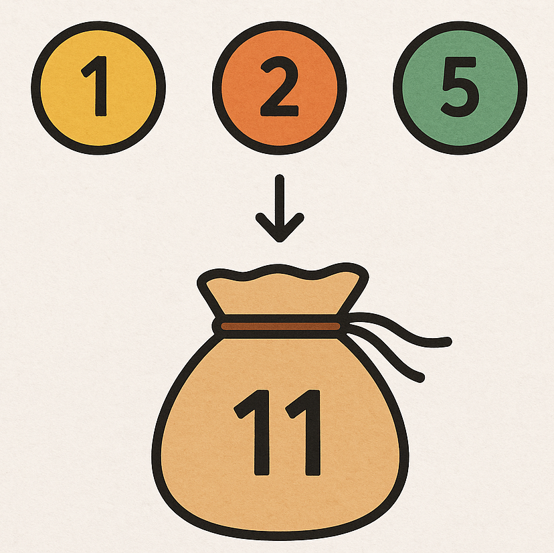
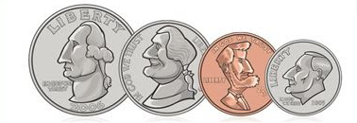
DP: Coin Change Problem (1)
Given a set of coin denominations and a target amount, determine the fewest number of coins needed to make up that amount.
If there is no combination that can achieve the amount, return -1

Slide 15
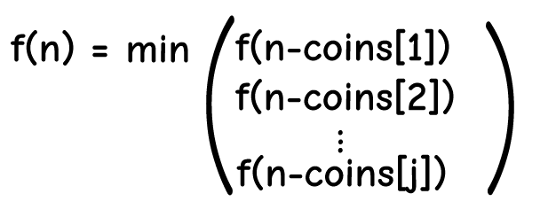
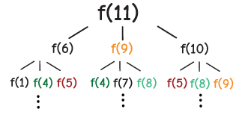
DP: Coin Change Problem (2)
Memoization
Example: coins = [1, 2, 5] , amount = 11
Notes:
Memoization

Slide 16
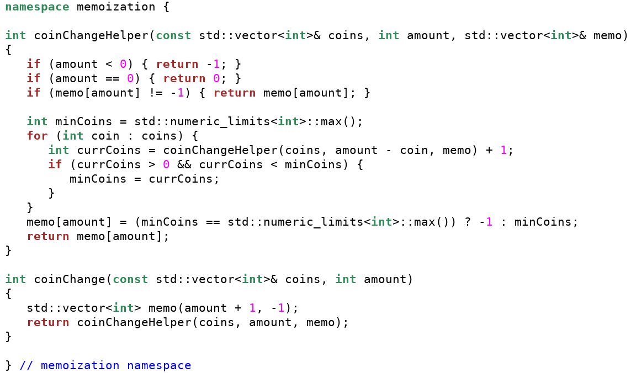
DP: Coin Change Problem (3)
Notes:
Time Complexity:
Description:
The memoization approach explores each amount recursively and stores results to avoid redundant calculations.
For each amount, the function potentially checks all coin denominations.
Complexity:
The worst-case time complexity can be O(amount * num_coins). This results from every subproblem (up to amount) needing to check all coins, though memoization should reduce actual calculations by storing results.
Space Complexity:
Description:
A memoization table (vector) of size amount + 1 is used to cache computed results.
The recursive call stack can grow until it uses memory proportional to amount.
Complexity:
O(amount) due to the memoization table storing results for each subproblem. Additionally, the recursive depth of the call stack also contributes to the same factor.

Slide 17
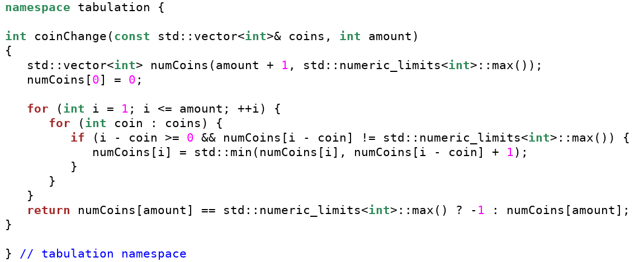
DP: Coin Change Problem (4)
Notes:
Time Complexity:
Description:
This approach involves iteratively building up solutions using a dynamic programming table.
For each amount from 1 to amount, it checks all denominations.
Complexity:
O(amount * num_coins) because the algorithm iterates through each subproblem (amount) and evaluates possibilities for each coin denomination.
Space Complexity:
Description:
A DP table (vector) of size amount + 1 is used for storing solutions to subproblems.
Complexity:
O(amount) because it employs a single-dimensional array to store the best-known results for each subproblem.

Slide 18
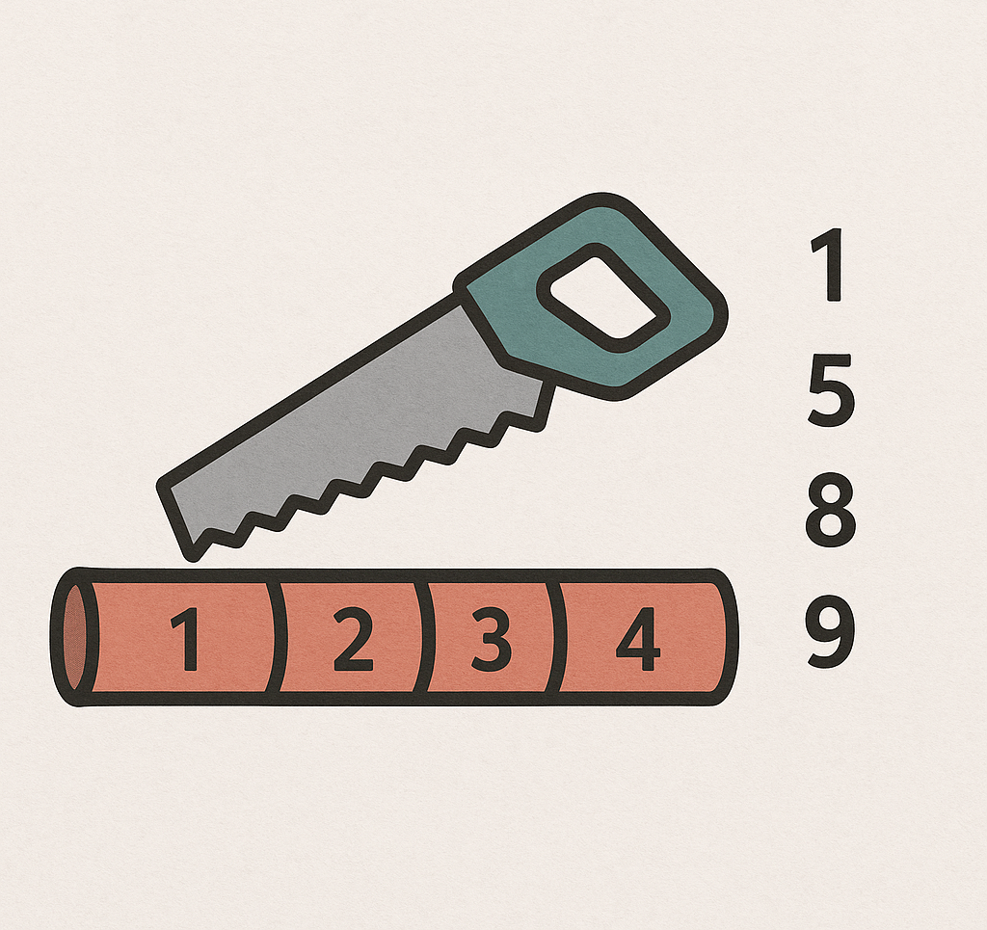
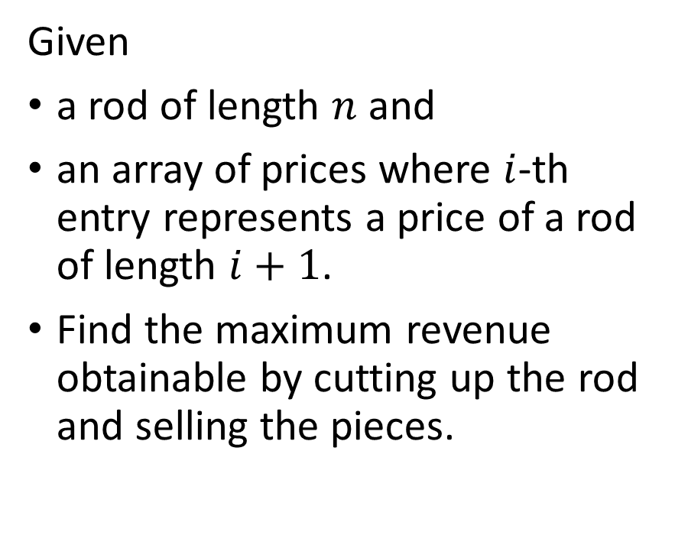
Rod Cutting Problem (1)
Given
a rod of length $n$ and
an array of prices where $i$-th entry represents a price of a rod of length $i+1$.
Find the maximum revenue obtainable by cutting up the rod and selling the pieces.

Slide 19
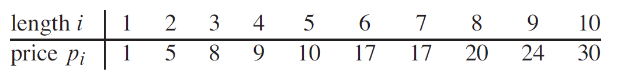
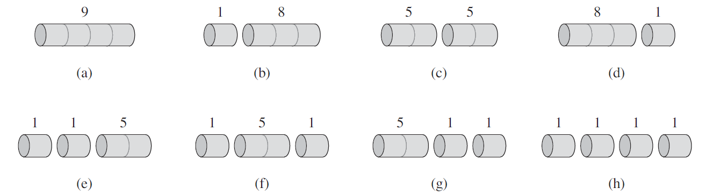
Rod Cutting Problem (2)
Notes:
2^n possible cuts

Slide 20
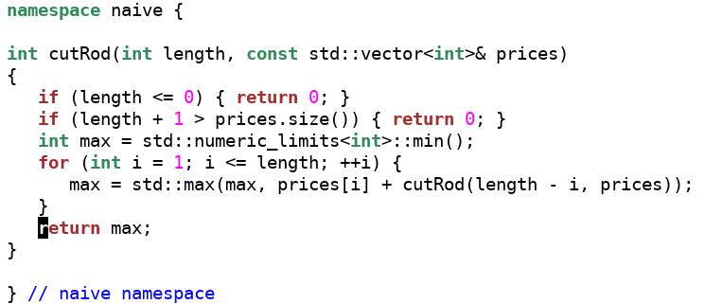
Rod Cutting Problem (2)

Slide 21
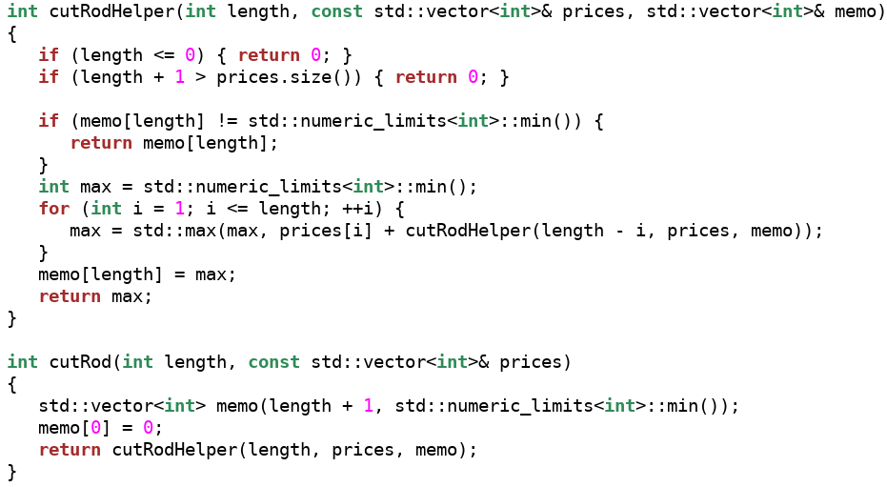
Rod Cutting Problem (3)
Notes:
memoization

Slide 22
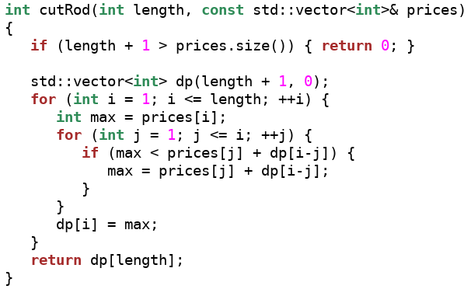
Rod Cutting Problem (4)
Notes:
tabulation

Slide 23
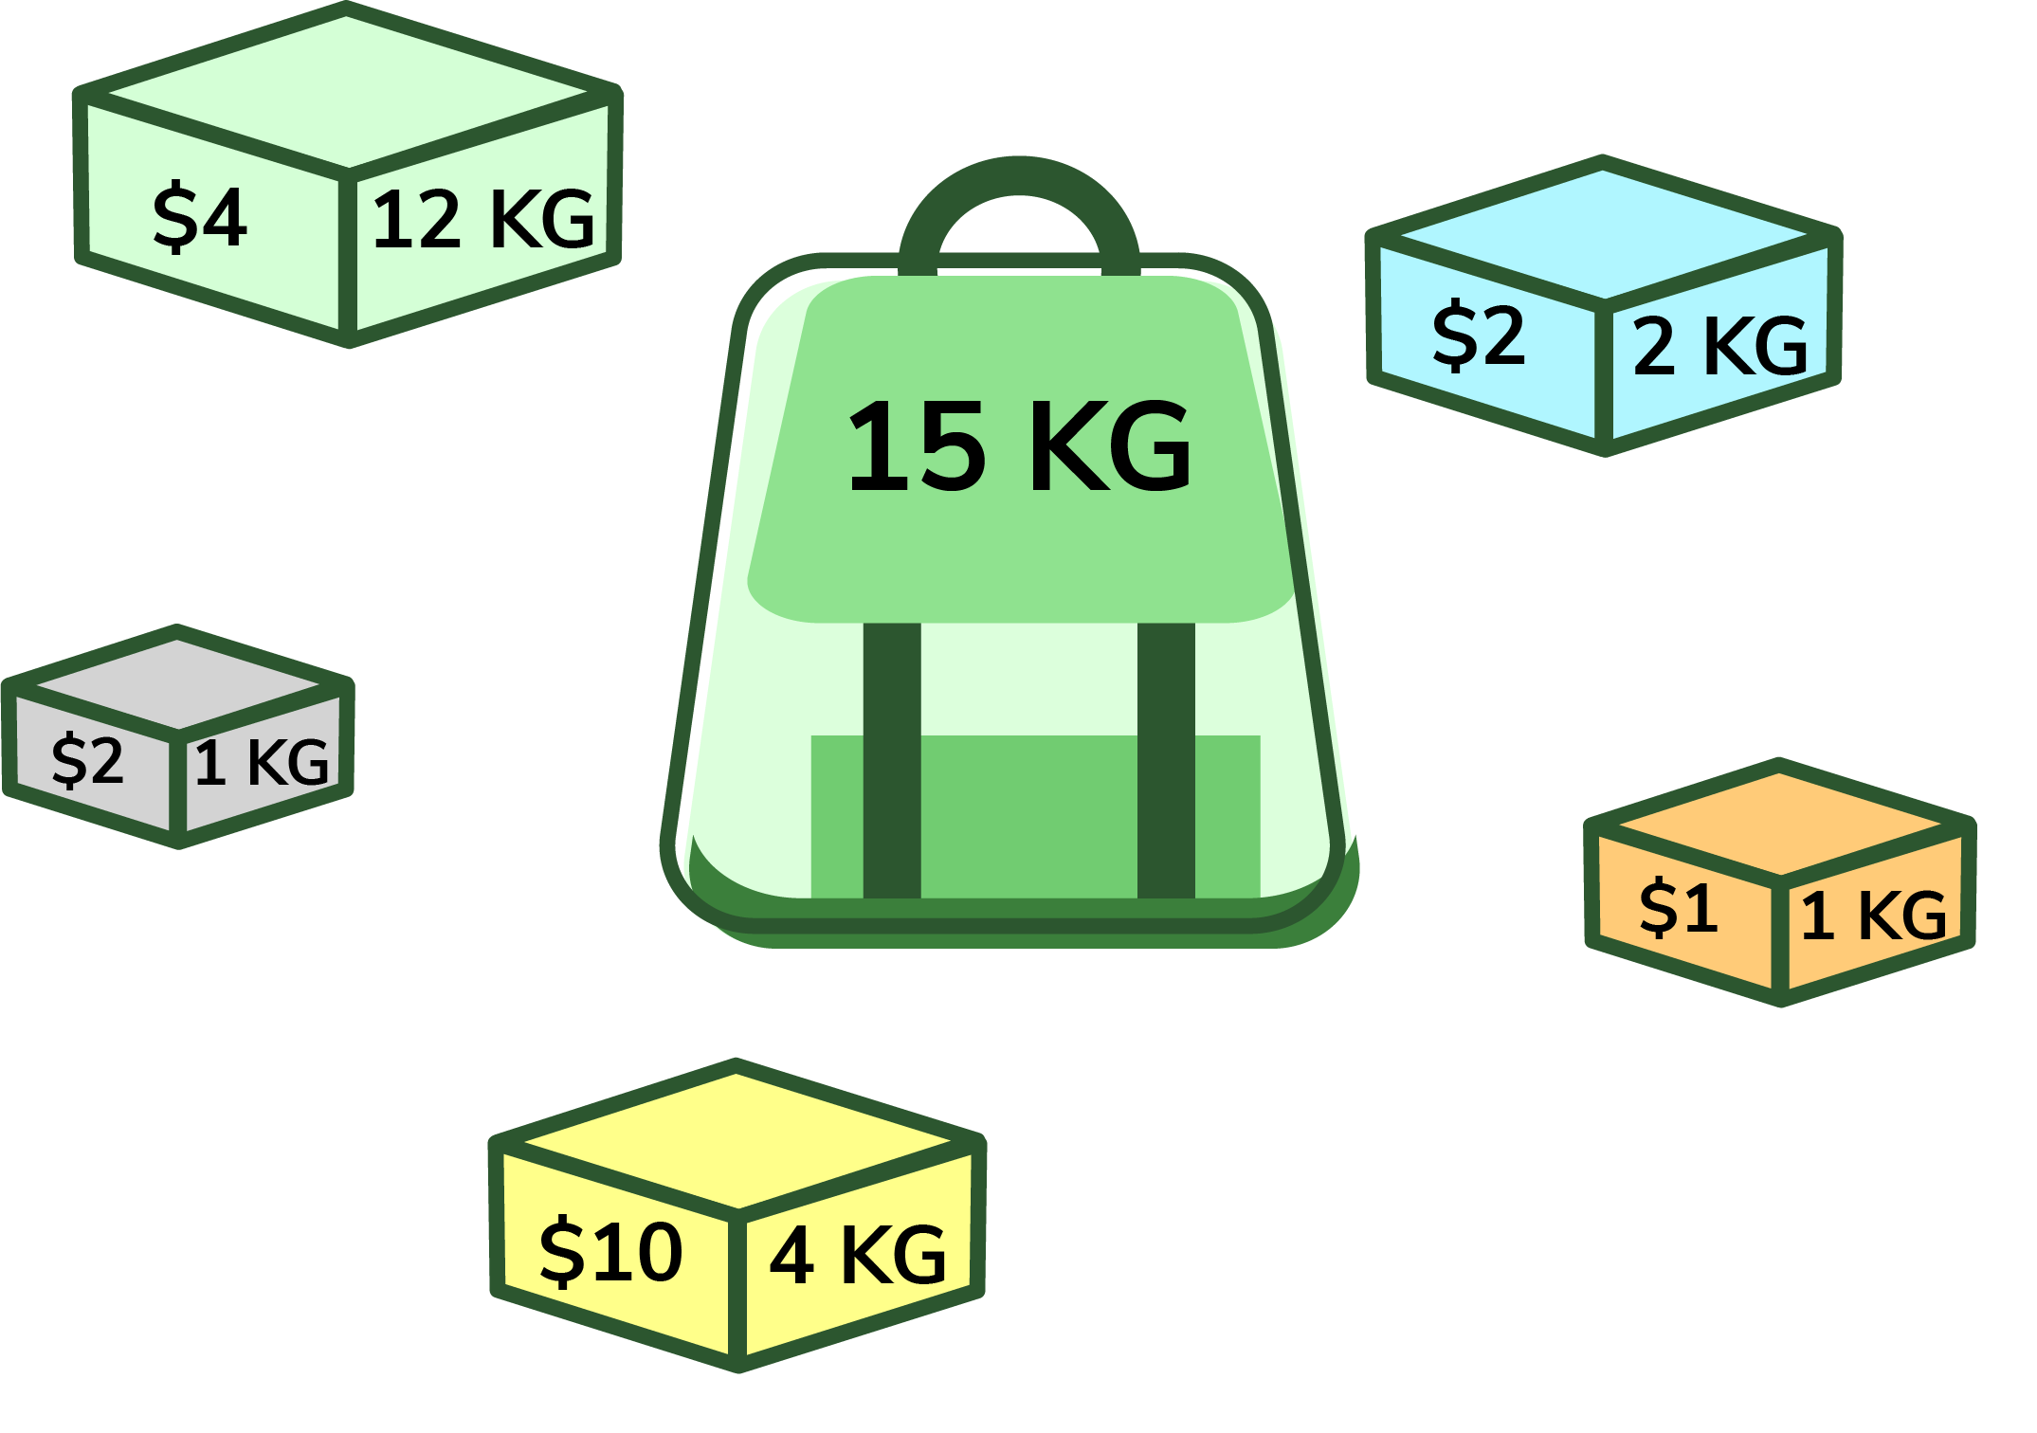
DP: Knapsack Problem (1)
Given a set of items, each with
a weight and
a value,
determine which items to include in a knapsack so that
the total weight does not exceed a given capacity, and
the total value is as large as possible.
Each item can be included at most once.

Slide 24
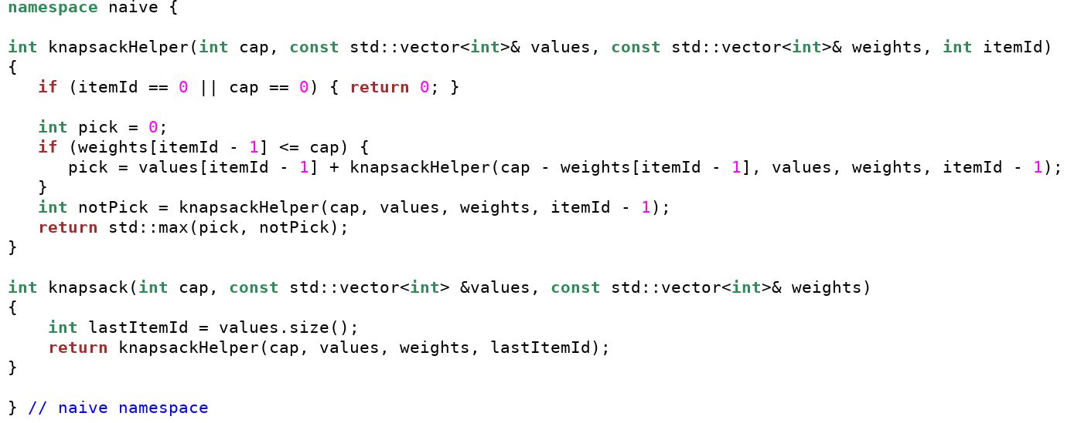
DP: Knapsack Problem (2)
Notes:
O(2^n) time

Slide 25
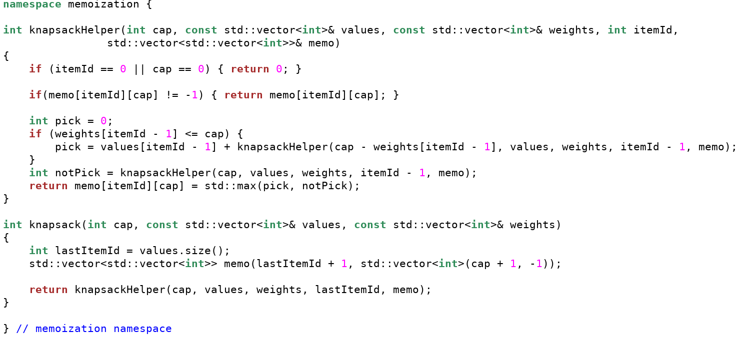
DP: Knapsack Problem (3)
Notes:
O(cap*itemCount)

Slide 26
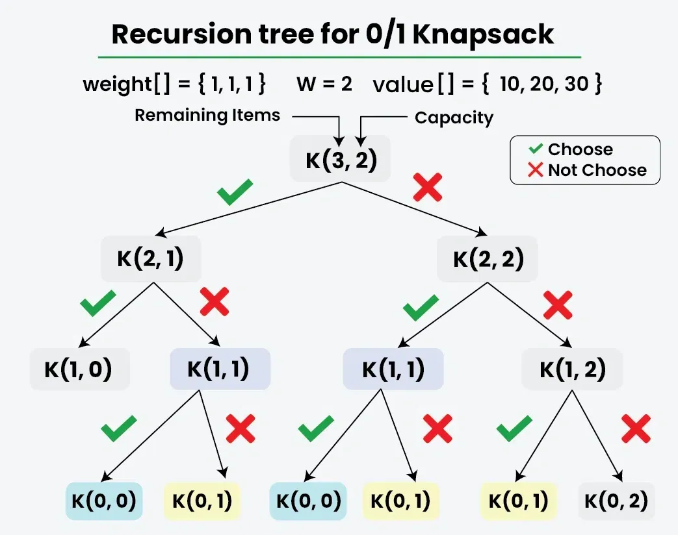
DP: Knapsack Problem (4)

Slide 27
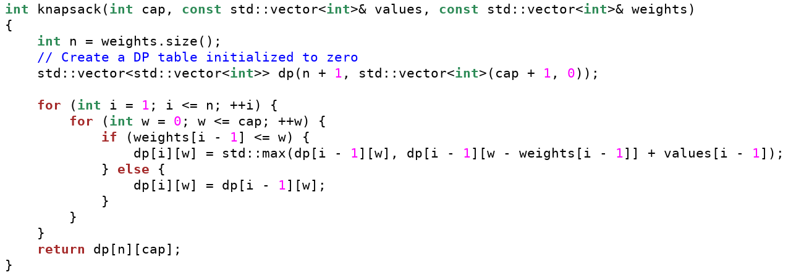
DP: Knapsack Problem (5)
Notes:
O(cap*itemCount)
dp[i][w] represent the maximum value that can be attained with the first i items within a weight capacity w

Slide 28
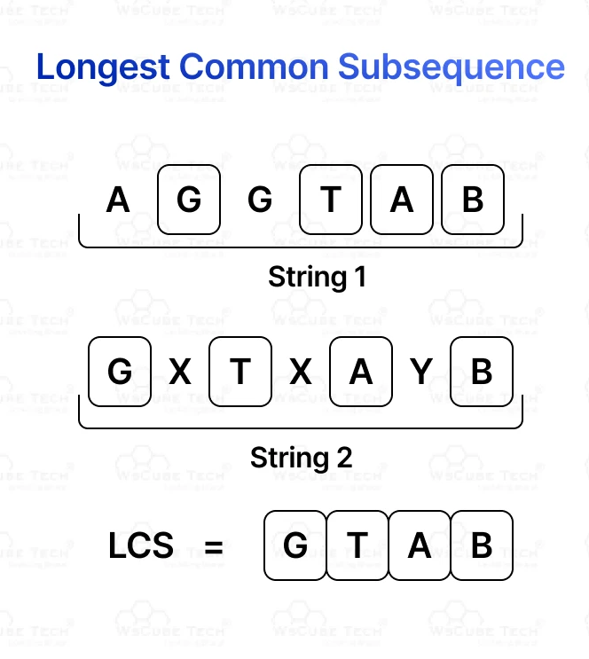
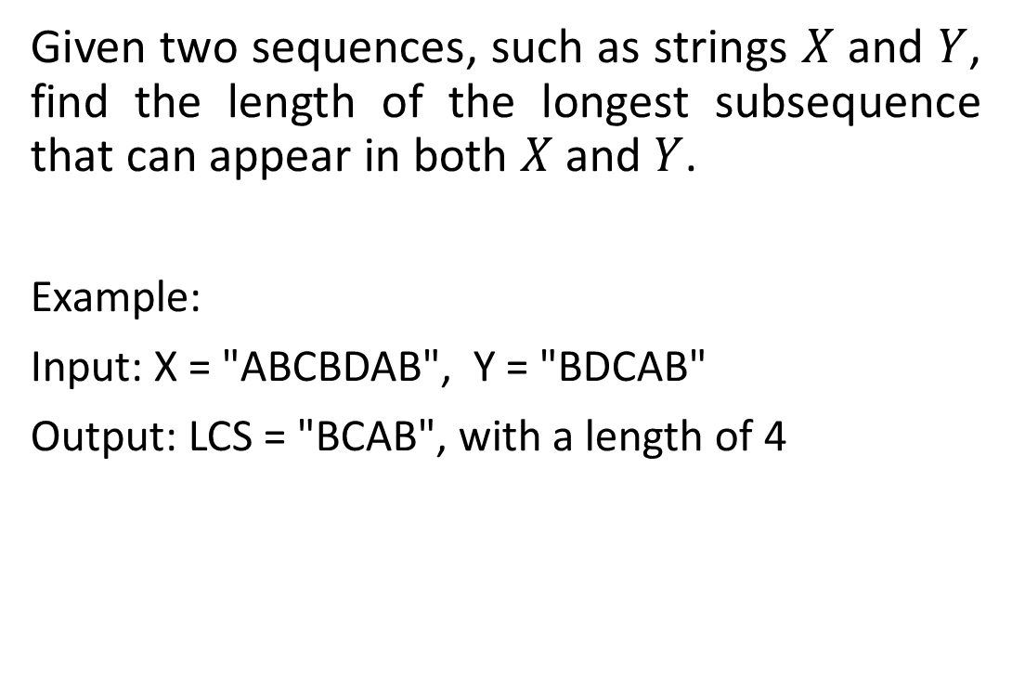
DP: Longest Common Subsequence (1)
Given two sequences, such as strings $X$ and $Y$, find the length of the longest subsequence that can appear in both $X$ and $Y$.
Example:
Input: X = "ABCBDAB", Y = "BDCAB"
Output: LCS = "BCAB", with a length of 4
Notes:
Example:
Input: X = "ABCBDAB", Y = "BDCAB"
Output: LCS = "BCAB", which has a length of 4

Slide 29
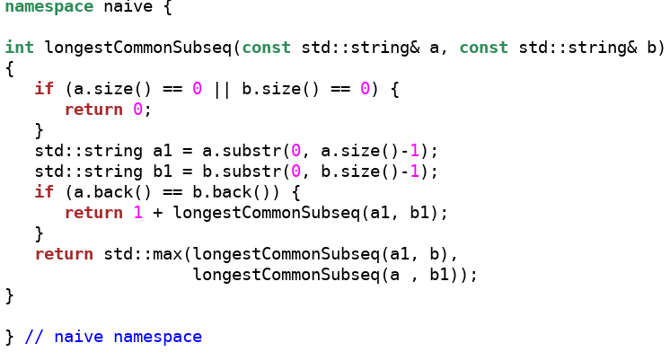
DP: Longest Common Subsequence (2)

Slide 30
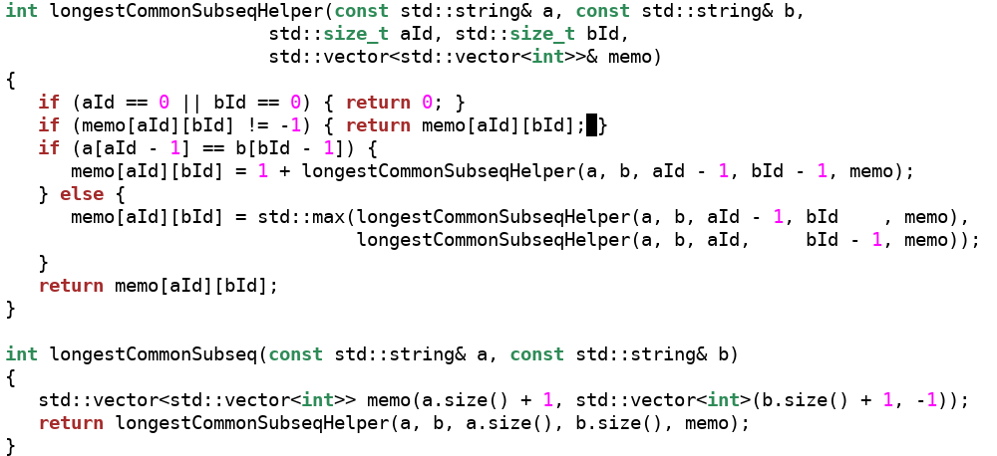
DP: Longest Common Subsequence (3)

Slide 31
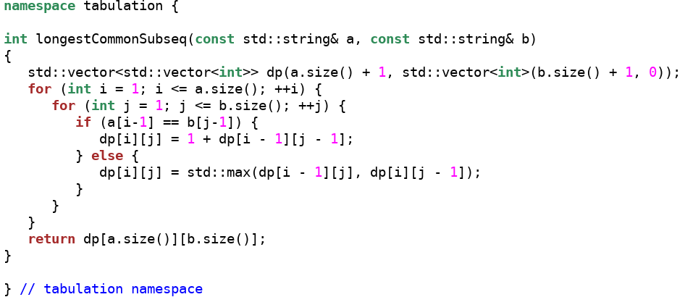
DP: Longest Common Subsequence (4)

Slide 32
Thank You

